Slide 1
An End-to-End Data Science Project with ChatGPT
TSP- AI ML Fundamentals (Capstone Project)
Presented By:
Subanu K R – AU810021214035
Guided By: Ramar Bose Sr. AI Master Trainer

Slide 2
OUTLINE
Problem Statement
Proposed System/Solution
Algorithm & Deployment
GitHub Link
Project Demo(photos / videos)
Conclusion
Future Scope
References

Slide 3
Problem Statement
With ChatGPT’s natural language processing (NLP) and machine learning, this research seeks to develop a loan approval system. To determine a new applicant’s creditworthiness, it will examine historical loan data. By integrating ChatGPT, you may improve the loan application process by automating customer interactions. The goal is to improve the user experience for both loan officers and applicants by increasing the accuracy and speed of approvals through the integration of conversational AI and analytics.

Slide 4
Proposed Solution
Preparing data for approval, creating features, and developing a machine learning model for loan approval prediction are all part of the planned end-to-end data science project utilizing ChatGPT and a loan dataset. Users can ask questions and receive help using a conversational interface thanks to ChatGPT integration. Model accuracy in practical situations is ensured by extensive testing.

Slide 5
Algorithm & Deployment
Data preprocessing: Clean and prepare loan dataset, handle missing values and outliers.
Feature engineering: Extract relevant information to enhance model performance.
Machine learning model training: Train model (e.g., logistic regression, random forest) to predict loan approval/rejection based on historical data.
Integration of ChatGPT: Enable conversational interface for user inquiries and assistance.
Testing and evaluation: Ensure model accuracy and effectiveness in real-world scenarios.

Slide 6
GitHub Link
https://github.com/Subanu4/subanuR.git

Slide 7
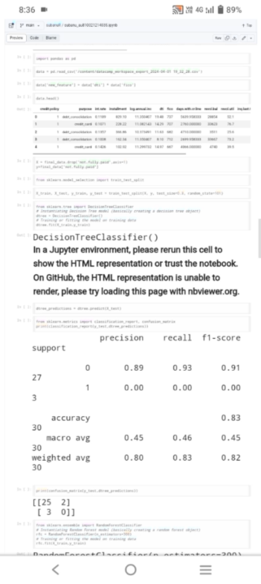
Project Demo(Recorded Video)

Slide 8
Conclusion
Implementing an end-to-end data project with ChatGPT for a loan dataset enhances customer engagement and service efficiency in lending. Through NLP, it facilitates seamless communication, providing instant assistance and guidance. Meticulous data preprocessing, model training, integration, and deployment ensure accurate and relevant responses, streamlining the user experience. Continuous monitoring and updates make the system adaptive and responsive to evolving user needs, optimizing loan management processes.

Slide 9
Future Scope
Utilizing ChatGPT for loan datasets has promising opportunities going forward. Sophisticated loan application systems will be made possible by advances in NLP and ML. Risk assessment can be improved by integrating several data sources, such as social media or transaction history. Accessibility can be enhanced via voice recognition. Trust and compliance can be guaranteed by cooperation with authorities and financial institutions. All things considered, ChatGPT’s future in loan management is quite promising in terms of innovation and financial inclusivity.

Slide 10
References
Project Github link, Ramar Bose , 2024
Project video recorded link (youtube/github), Ramar Bose , 2024
Project PPT & Report github link, Ramar Bose , 2024

Slide 11
THANK YOU

